Slide 1
System Panic
Presenters:
Alek - Co-Level Design Lead

Slide 2
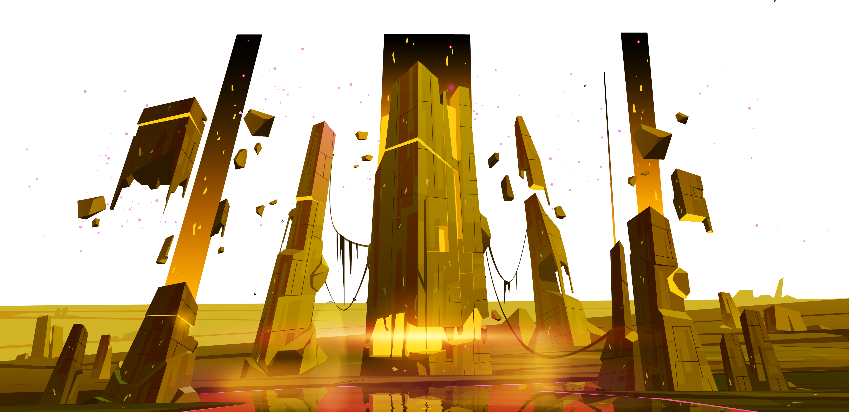
Bosses

Slide 3
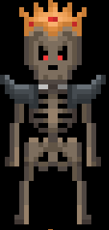
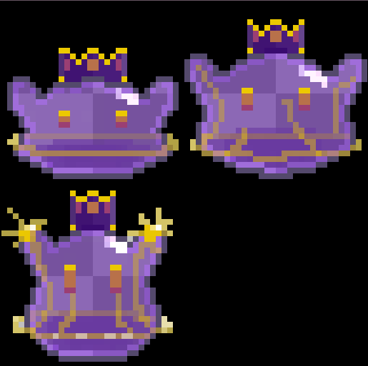
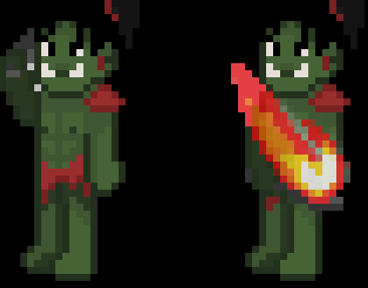
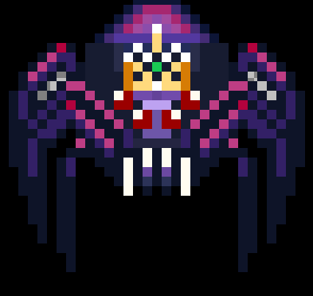
King Skeleton
King Slime
King Orc
Queen Spider
Art - Bosses

Slide 4
Intro

Slide 5
^{April 6th 2025}

Slide 6
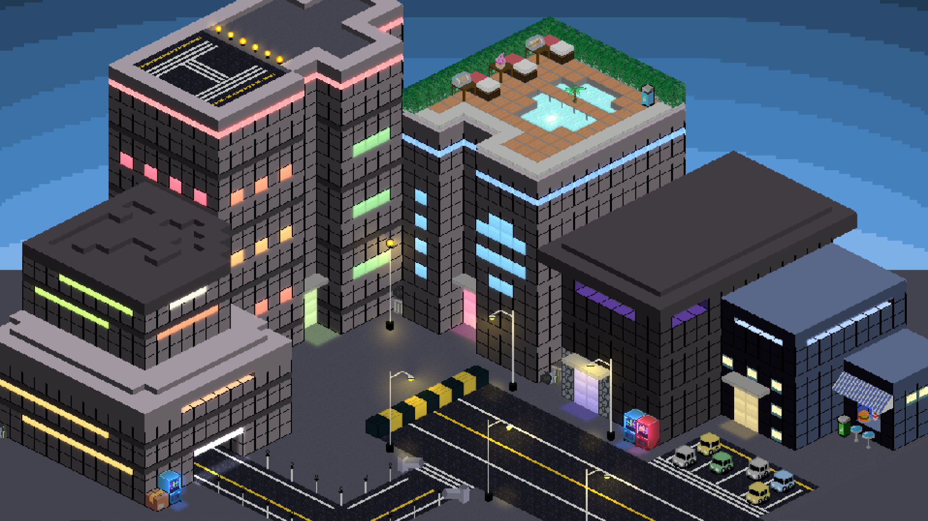
The day the world changed
The System arrived

Slide 7
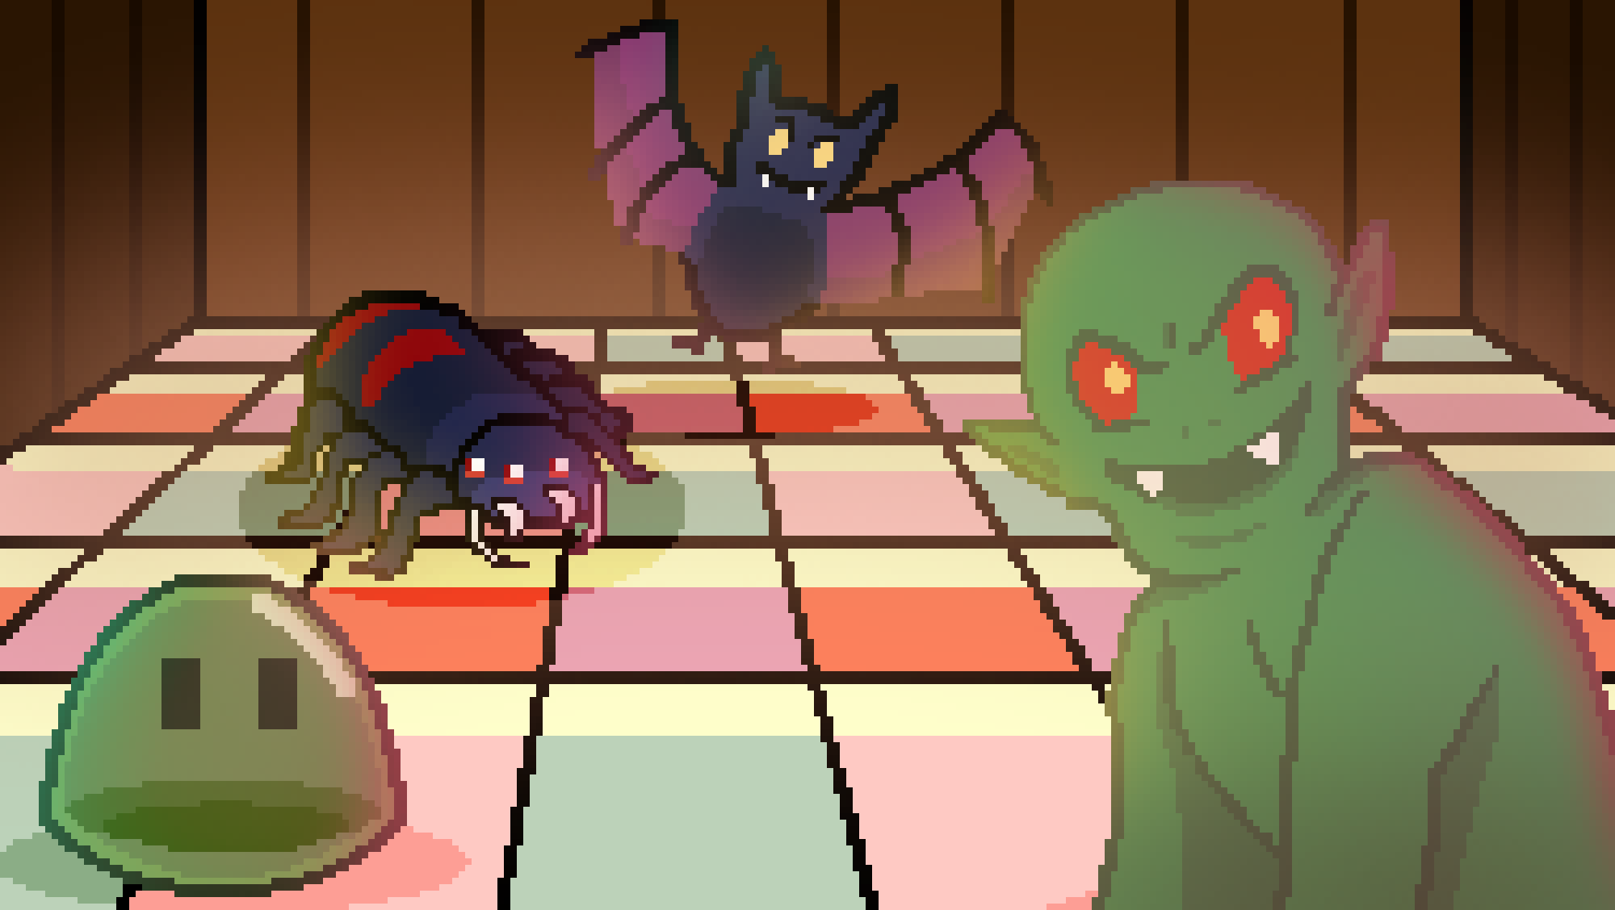
Buildings became monster infected dungeons

Slide 8
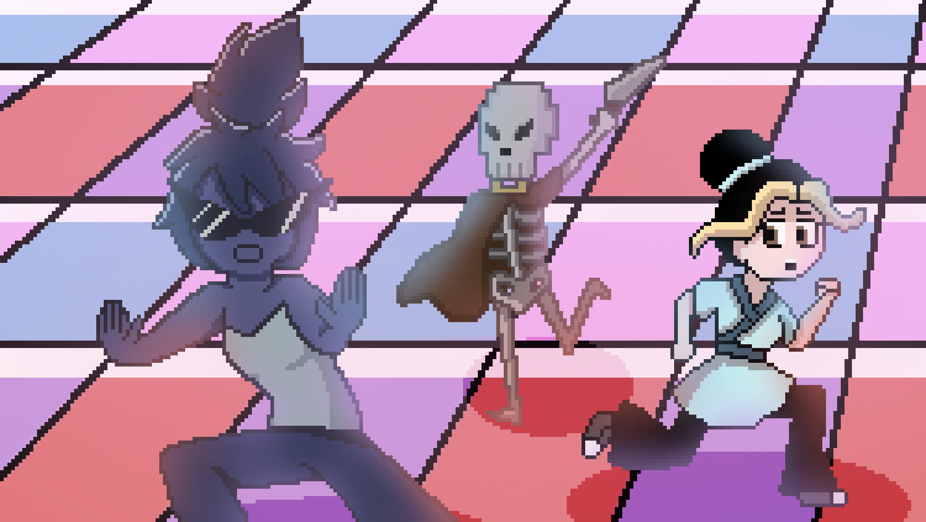
At first the world was chaos

Slide 9
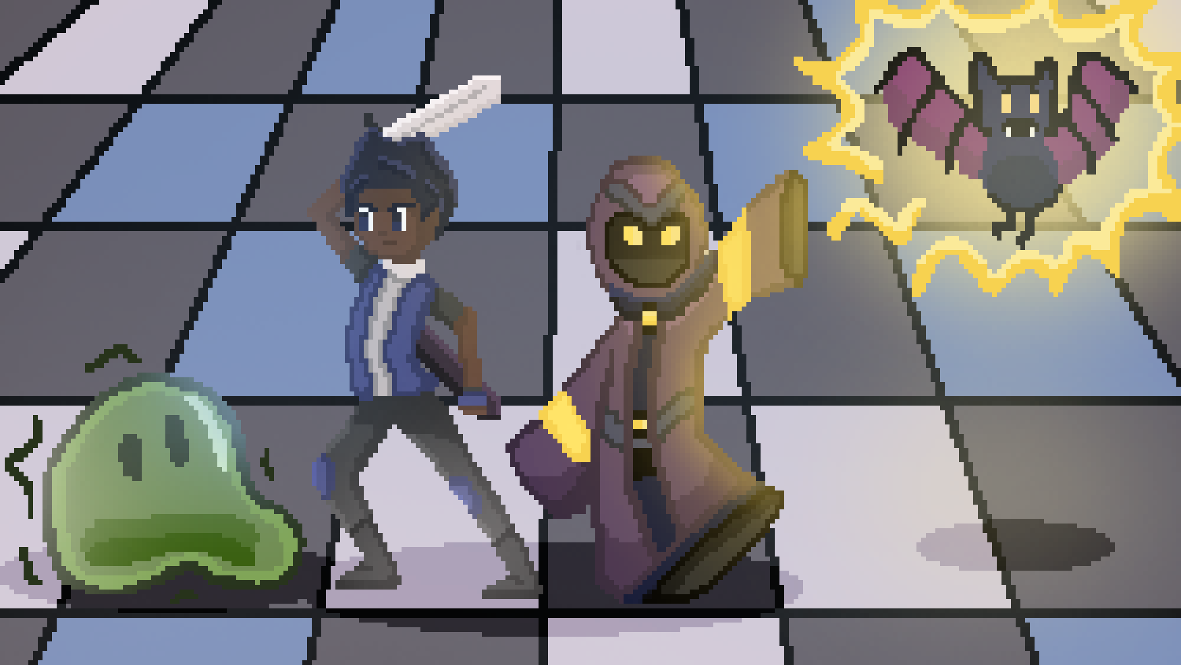
But soon we adapted
The streets became a safe haven

Slide 10
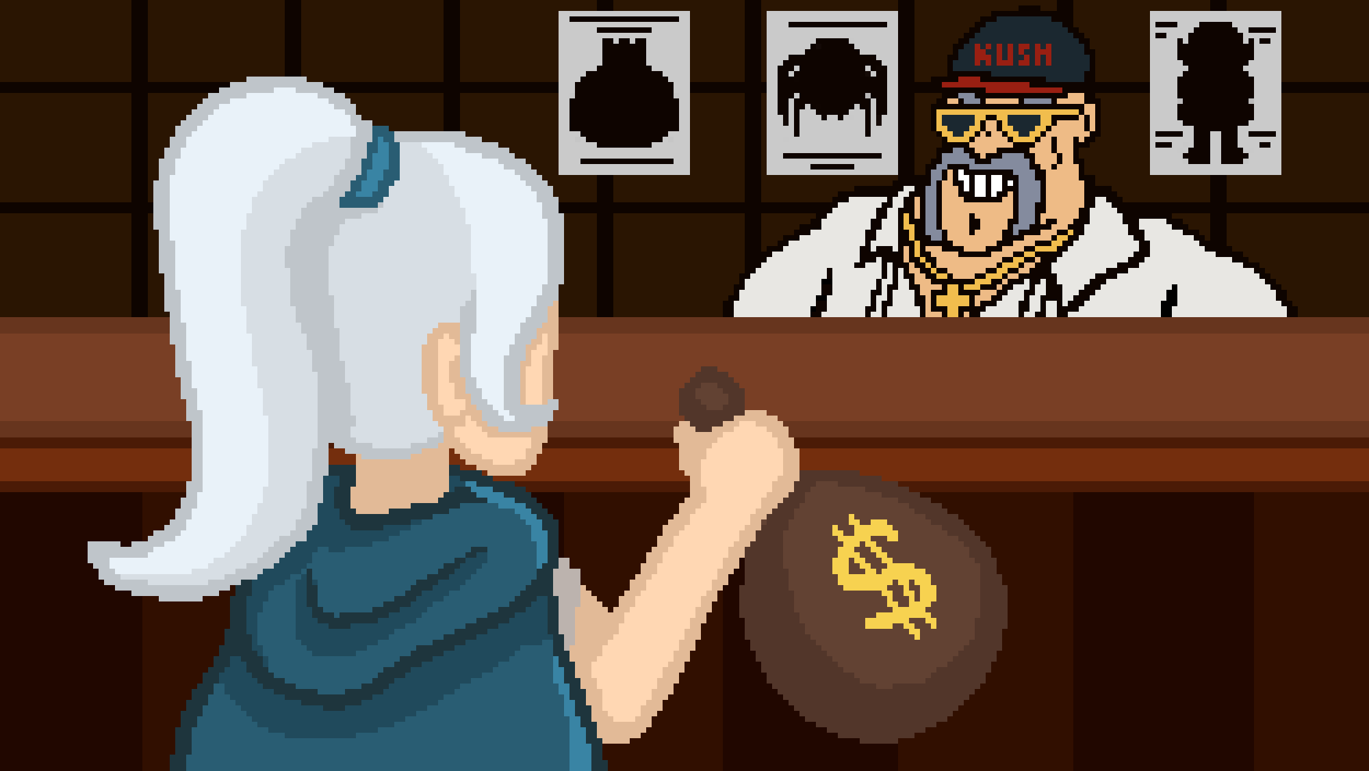
Hunting became just another job
A way to make money

Slide 11

Whoever defeated the 3 kings
Would gain great power and wealth

Slide 12
Thanks!
Questions? Feedback?

